Slide 1


Data Preparation and Modelling
Created by:
Grzegorz Meller
Mateusz Rock
Tomasz Wierciński
Robert Zwierzycki

Slide 2
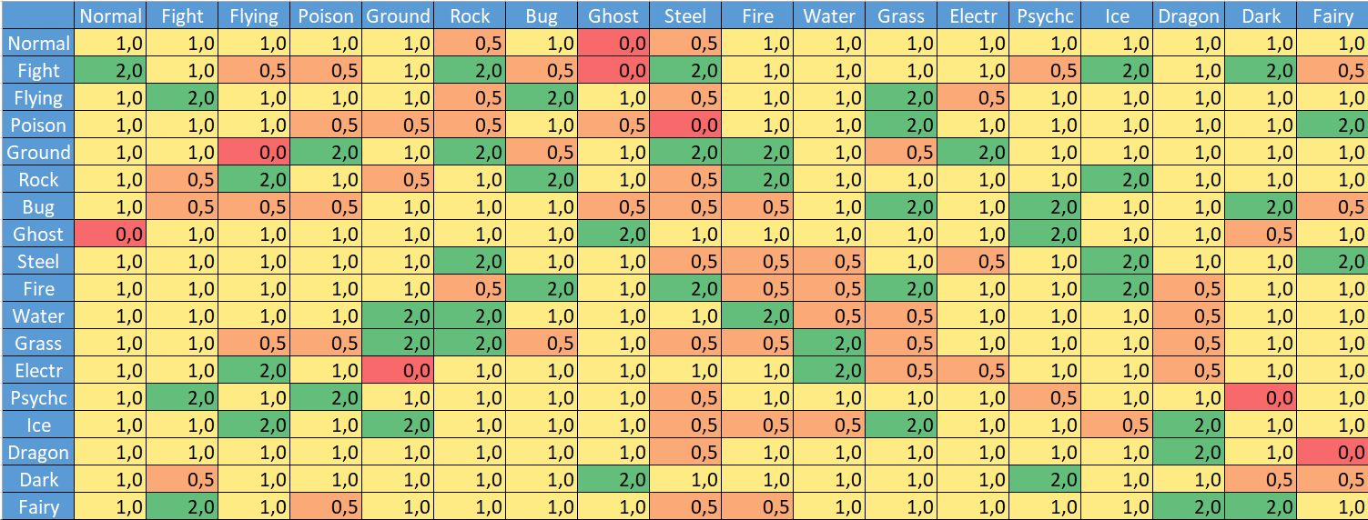
Data Supplementation

Slide 3
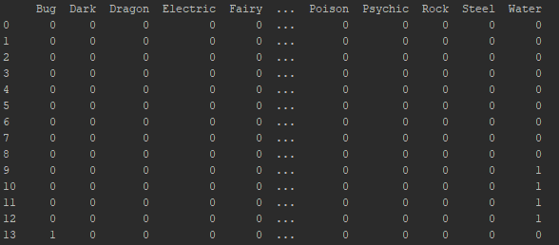
Data Conversion
One Hot Encoder is a method which encodes categorical variables into one-hot numeric array.

Slide 4
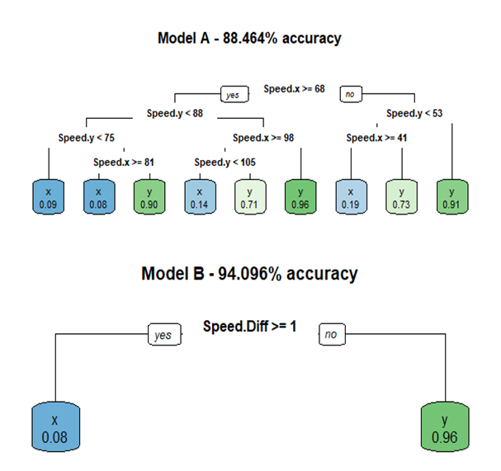
Created Models
1. Will you be able to predict the outcome of future combats?
Decision tree
Trained on 75% and tested 25% of the available samples
Two models were created.
Model A - trained on all the numerical and nominal attributes related to the two combatants
Model B - trained on the multipliers calculated using the types of the two pokemon and the differences between their numerical attributes

Slide 5
Created Models
2. Is it possible to build a classifier to identify legendary Pokemon?
KNN Classifier
Trained on 70% and tested on 30% of the dataset.
Type 1 and Type 2 were converted into nominal values using one hot encoding method.
Model building:
Model was build by fitting appropriate columns from training data into the corresponding legendary status.
Results:
The most optimal number of neighbours happened to be 3
95.4% of accuracy.

Slide 6



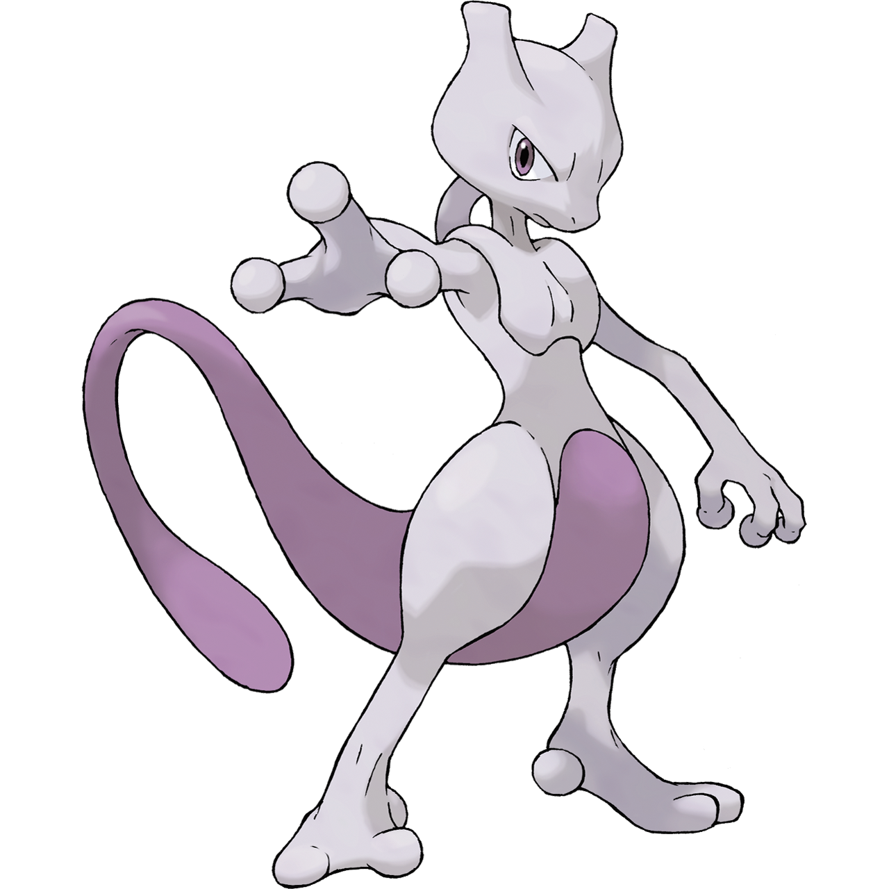


Created Models
3. Can you build a Pokemon dream team (6 pokemons)?
Aerodactyl
Jirachi
Mewtwo
Infernape
Slaking
Deoxys Speed Forme

Slide 7

Created Models
4. Which pokemon is the strongest overall? Which is the weakest?
Pumpkaboo Small Size
Mewtwo

Slide 8
Thank you for your attention!

